Slide 1
TEM results on laser structures: AlN bulk vs. ELO-AlN as well as with/without superlattice
Anna Mogilatenko
Ferdinand-Braun-Institut Leibniz-Institut für Höchstfrequenztechnik

Slide 2
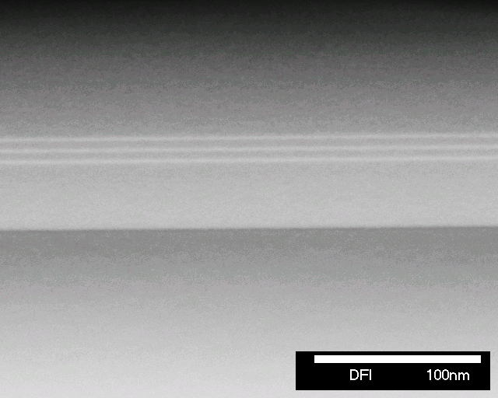
TS4045-1: Growth on bulk AlN

Slide 3
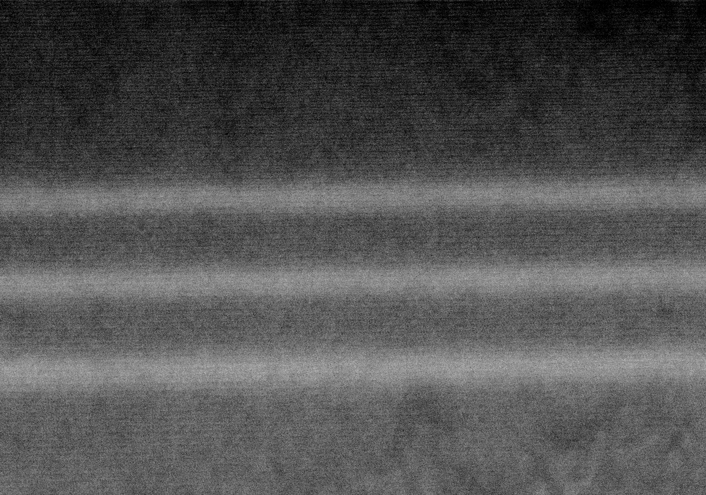
TS4045-1: Growth on bulk AlN
Barriers: ~ 4.5 nm
QWs: ~ 1.75-2 nm
No abrupt interfaces, symmetric QW profile

Slide 4
TS4045-2H: Growth on ELO-AlN, no superlattice

Slide 5
TS4045-2H: Growth on ELO-AlN, no superlattice
bottom cladding
v-pits
bottom cladding
ELO-AlN
dislocation inclination already in AlN (TU AlN/FBH AlN)

Slide 6
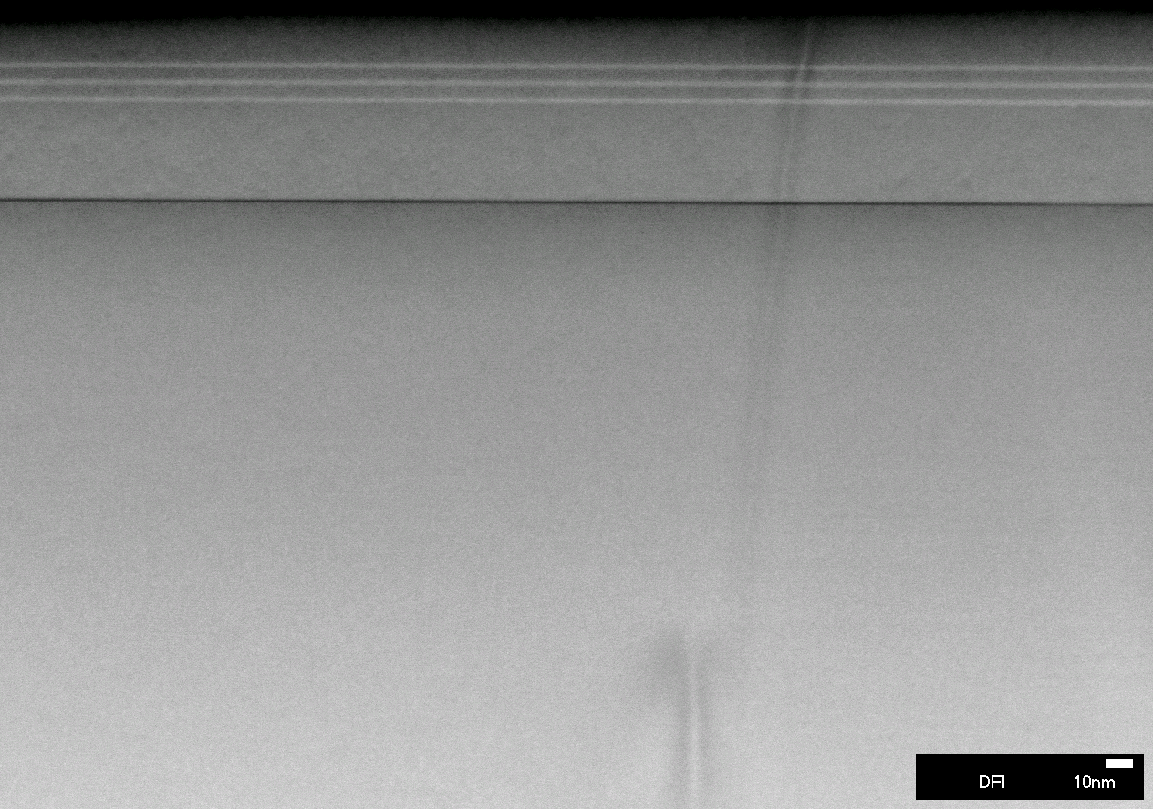
TS4045-2H: Growth on ELO-AlN, no superlattice

Slide 7
TS4045-2H: Growth on ELO-AlN, no superlattice
Al-K
bottom AlGaN waveguide: Al_{0.66}Ga_{0.34}N
Ga-L
Interface: Al_{0.86}Ga_{0.14}N
bottom cladding: used as reference Al_{0.8}Ga_{0.2}N
Al-rich layer between the bottom WG and bottom cladding

Slide 8
TS4045-2H: Growth on ELO-AlN, no superlattice
Barriers: ~ 4.25-4.5 nm
QWs: ~ 1.75 - 2 nm

Slide 9
TS4045-2H: Growth on ELO-AlN, no superlattice
profile 2
profile 1

Slide 10
TS4045-2H: Growth on ELO-AlN, no superlattice
step?
above a trench

Slide 11
TS4045-2H: Growth on ELO-AlN, no superlattice
profile 1
profile 2
step?
above a trench

Slide 12
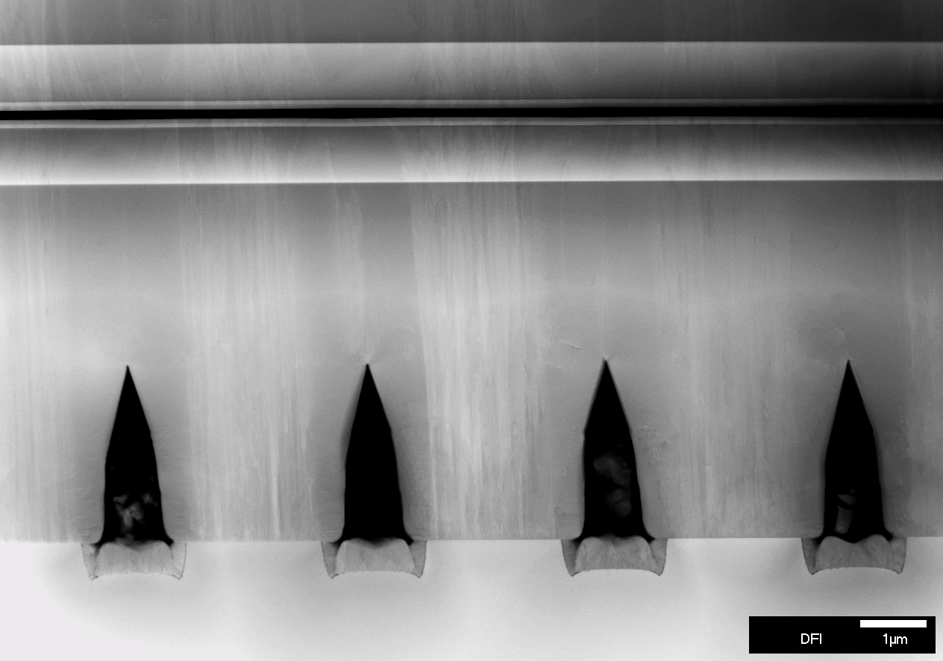
TS4048-2H: Growth on ELO-AlN with superlattice
no v-pits

Slide 13
TS4048-2H versus TS4045-2H

Slide 14
TS4048-2H: Growth on ELO-AlN with superlattice
3 nm
superlattice fades out
superlattice
AlN

Slide 15
TS4048-2H: Growth on ELO-AlN with superlattice
3 nm
superlattice fades out

Slide 16
TS4048-2H: Growth on ELO-AlN with superlattice
3 nm
superlattice is there

Slide 17
TS4048-2H: Growth on ELO-AlN with superlattice
bottom AlGaN waveguide
3 nm
Ga desorption
superlattice: 5ML x 2ML x 3ML
1.25 nm x 0.5 nm x 0.75 nm
Nominal thicknesses: 2 nm x 2 nm
superlattice almost dissolved

Slide 18
TS4048-2H
superlattice
superlattice

Slide 19
TS4048-2H: Growth on ELO-AlN with superlattice
Barriers: ~ 4-4.5 nm
QWs: ~ 1.5-2 nm

Slide 20
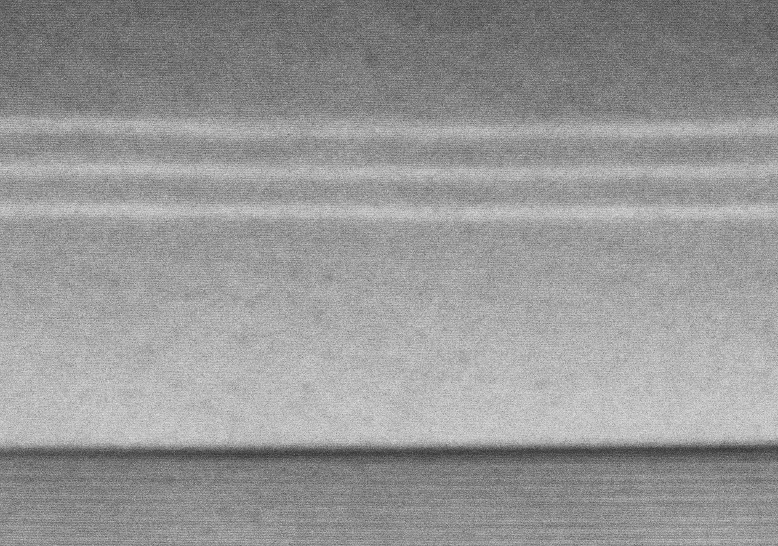
TS4048-2H: Growth on ELO-AlN with superlattice
4 nm
QWs above a trench

Slide 21
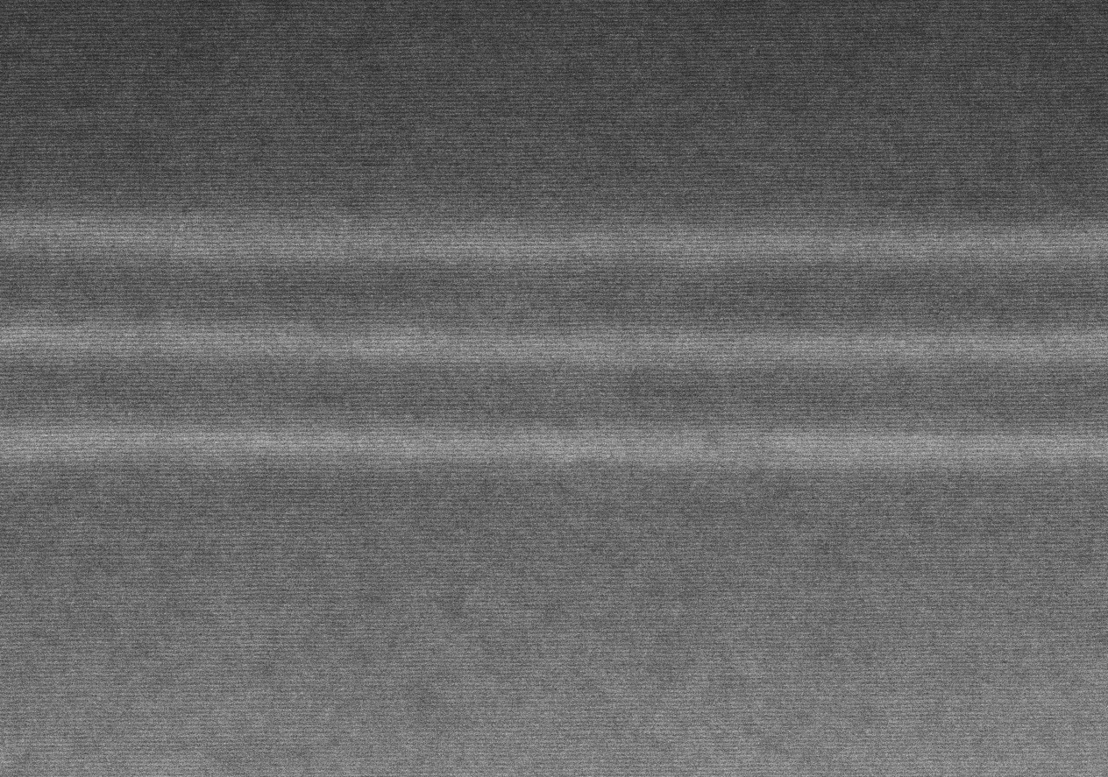
TS4048-2H: Growth on ELO-AlN with superlattice
QWs above a trench
QWs above a ridge
Tendency: QWs are smoother above the ridges

Slide 22
TS4048-2H: Growth on ELO-AlN with superlattice
QWs above a trench
profile 1
profile 2
bottom QW
top
QW

Slide 23
Summary
QW/Barrier thicknesses are comparable
For samples on ELO-AlN slight thickness inhomogeneities above trenches
V-pits
Superlattice fades out in the middle, but is present at the beginning and at the end of the growth
ADF detector is required to show clearly the dislocation line propagation (however up to now – no noticeable changes in dislocation propagation)
Further steps for structural analysis of layers on bulk AlN? FIB-preparation?

Slide 24
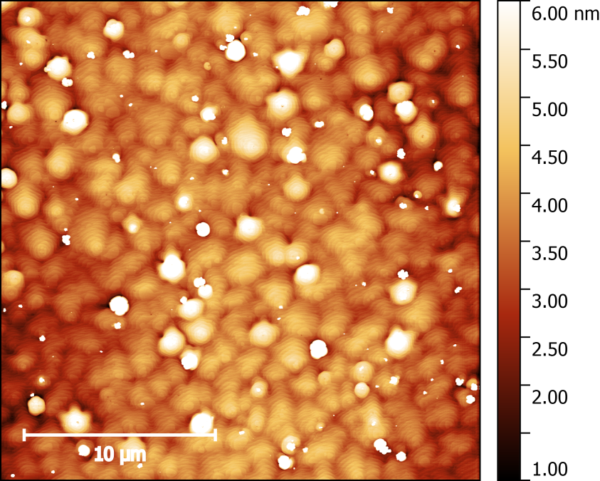
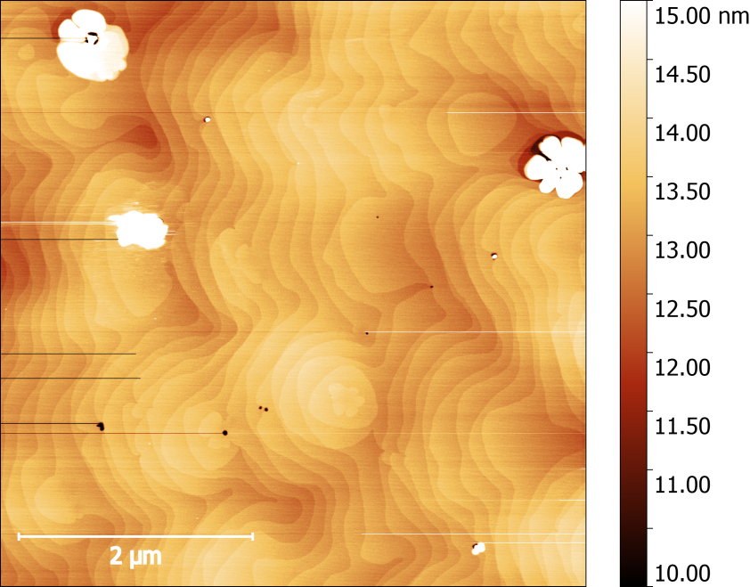
TS4045-1: growth on bulk AlN

